Slide 1

Introduction to Programming Languages
CA1104/CA2104
1

Slide 2
A programming language comprises of a set of commands, instructions and has a syntax specified.
It enables communication between a computer and a user.
Used to create programs that implement algorithms.
Computers only understand binary (0s and 1s). A programming language helps translate human logic into instructions that a computer can follow.

Slide 3
 Based on the Hierarchy
Low Level PL
Middle Level PL
High Level PL
Based on programming style
Structured PL
Un-structured PL
Based on programming paradigm
Procedural Oriented PL
Object Oriented PL

Slide 4
Programming languages based on hierarchy
Low Level programming languages (System Friendly Languages)
It can be further classified into
Machine Level Language
Language comprising of only binary numbers 0 and 1.
Instructions and Data are specified in sequence of 0 and 1. Eg: 00001000 00000100 00000101…
It is difficult to differentiate between instruction and data thus difficult to code.
They are faster in execution but are highly machine dependent.

Slide 5
Programming languages based on hierarchy
Low Level programming languages contd..
Assembly Level Language
Instructions are specified using machine operational codes (mnemonics) and data can be specified in various format (in decimal, octal, hexa-decimal etc…)
Eg: MOV A, 05
MOV B, 06
ADD A, B
They are faster in execution but are highly machine dependent.
Requires a translator for converting assembly level codes to binary codes (Assembler).

Slide 6
Programming languages based on hierarchy
High Level Programming languages
These languages are easier for humans to understand and code, thus more user friendly.
It consist of English-like statements that makes a program. Eg: JAVA
These languages are highly portable.
Requires a translator for converting high level codes to binary codes (Compiler or interpreter).

Slide 7
High level vs. low level programming languages
Parameters | High Level PL | Low Level PL
Platform Dependencies | Platform independent | Platform dependent
Speed | Slower in execution | Faster in execution
Easiness | easy to write, read, modify and understand | Difficult to code as instruction and data are specified in 0’s and 1’s.
Translation | Requires translator (assembler, compiler or interpreter) | Does not require translator
8

Slide 8
Programming languages based on hierarchy
Middle Level programming languages
These languages consist of the feature of both high level as well as low level programming languages.
Eg: C, C++
8

Slide 9
Structured programming languages
 Structured programming follows a structure aimed to improve clarity, readability and interpretability.
Programming languages based on programming style
It follows well defined structures (sequence, selection, iteration)
Sequence: Instructions are executed one after another.
Selection: a choice can be made to execute certain set of instructions based on conditions.
Iteration: certain statements can be repeatedly executed to perform a task based on a condition.
9

Slide 10

Unstructured PL:
Programming languages based on programming style
Does not enforce a clear program structure.
Programs are typically written as one long sequence of instructions with frequent use of jumps or goto statements,
 For eg:
Inst1
Inst2
Inst3
goto inst7
Inst5
Inst6
inst7
* Executable Code
* Unreachable Code
10

Slide 11
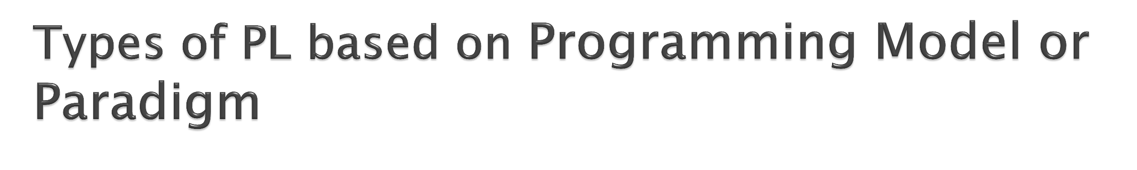
Procedural Programming Model | Object Oriented Programming Model
It follows top down design approach. Program is divided into small modules or functions. Emphasizes more on functions It does not have proper way to hide data so is less secure. Eg: C, VB, PASCAL | It follows bottom up design approach. Program is divided into parts called Object. Emphasizes more on data. It provides concepts of data-hiding thus more secure. Eg: C++, JAVA, VB.NET
11

Slide 12
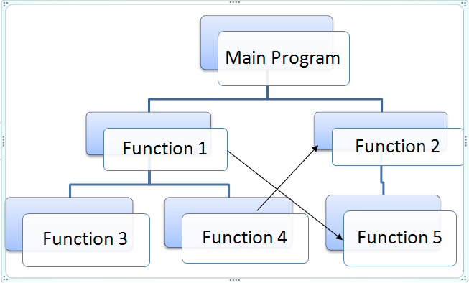
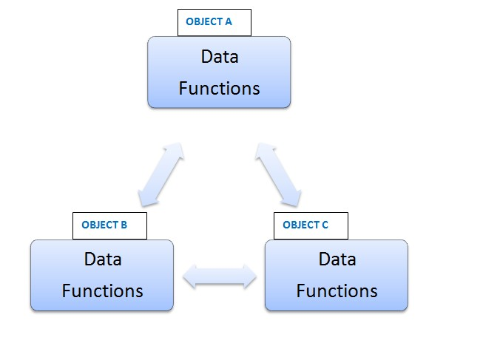
Procedural Programming Model | Object Oriented Programming Model
12

Slide 13
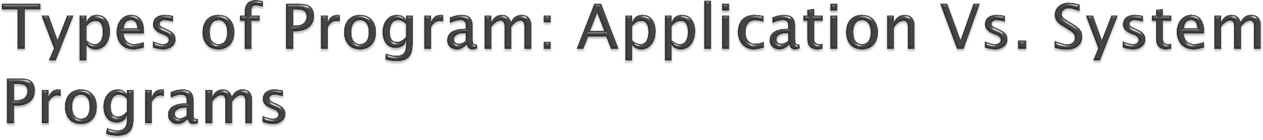
BASIS FOR COMPARISON | SYSTEM SOFTWARE | APPLICATION SOFTWARE
Basic | System Software provides a platform for application software to run. | Application Software are designed for performing specific tasks.
Language | System Software is written in a low-level language, i.e. assembly language. | Application Software is written in a high- level language like Java, C++, .net, VB, etc.
Run | System Software starts running when the system is turned on, and runs till the system is shut down. | Application Software runs as and when the user requests.
Requirement | A system is unable to run without system software. | Application software is even not required to run the system; it is user specific.
Examples | Operating system, Compilers etc. | MS-Word, WhatsApp, etc.

Slide 14
Components used for execution of computer programs
Compiler/Interpreter
Assembler
Linker
Loader

Slide 15
Components used for execution of computer programs
Compiler:
It is a system program that translates program written in High Level Language into Machine Level Language in one go and lists out errors if any.
Interpreter:
It is a system program that translates program written in High Level Language into Machine Level Language line by line.

Slide 16
Assembler:
Components used for execution of computer programs
It is a system program that translates program written in Assembly Level Language into Machine Level Language.
Input to the assembler is known as Source program and Output from an assembler is known as Object program.
It also provides some information to the Loaders.

Slide 17
Components used for execution of computer programs
Linker & Loader:
 Linker is a system program that resolves the problem of externally referenced entities (function or data referred in one routine but defined in some other routine or vice versa).
 Loader is a system program that loads an object program in core memory and prepares it for execution.

Slide 18
 An Operating system is the system software that bridges a gap between hardware and the software.
Components used for execution of computer programs
Operating Systems:
It is concerned with the allocation of resources and services such as
memory, processors, device and information.
It includes various program: memory management module, traffic controller, scheduler, I/O programs and a file system.

Slide 19

C Programs ^{Editors} |  |  | Prog.c
Prog.c Compilers |  |  | Prog.obj
Prog.obj | Linkers & Loaders |  | Prog.exe
Operating System
CA1104/CA2104
18

